Slide 1
Using Big Data Tools for Image Classification - Progress Report
Miles Franklin, Cliff Mbah

Slide 2
Project Goals
Goal #1:
Create a Decision Tree Classifier that accurately predicts race as a category
Goal #2 (Time permitting):
Implement Goal #1 in a video format
This will require Tensorflow object detection and may require an additional model
Goal #3 (Time permitting):
Implement Goal #2 in with Real-Time learning
Improving Velocity of Learning

Slide 3
Accomplishments
Data Collection
Data Storage
Decision Tree Classifier
Expected Result
Additional Goals
Web scrape Google Images for portraits by race. (Black, White, Asian, Latino)
Store into MongoDB using pymongo.
Use sklearn Decision Tree Classifier to train image classifier. Target will be race.
Create a machine learning model that accurately can predict the race of a portrait.
TensorFlow - Implement so that it can be run in video (ML model to identify if portrait that then triggers ML model to identify race)
Notes:
Decision Tree Classifier: sklearn.tree.DecisionTreeClassifier — scikit-learn 0.23.2 documentation
Tensor Flow: Object detection

Slide 4
Data Management

Slide 5
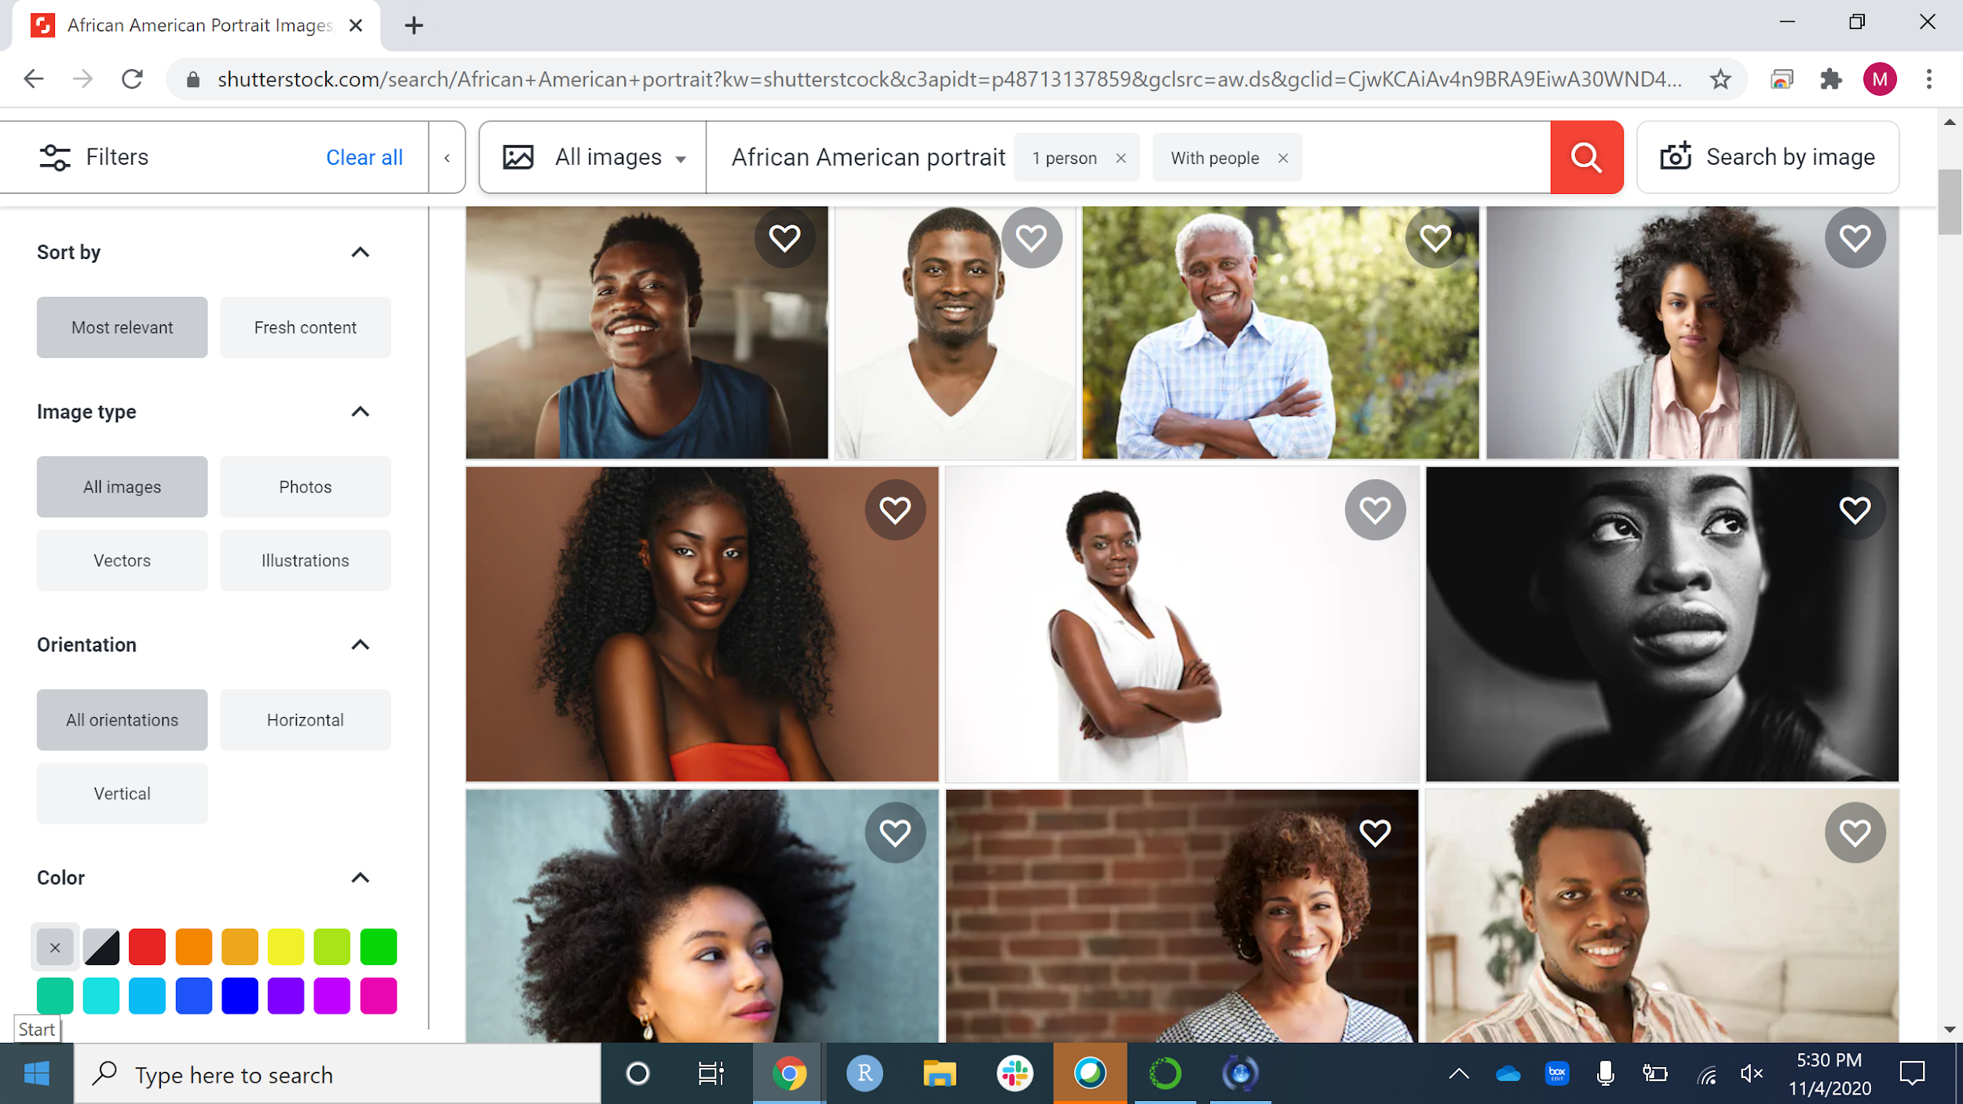

Slide 6
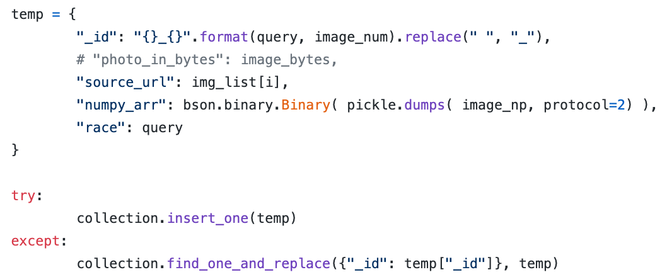
Data Formatting (Web Scraping)

Slide 7
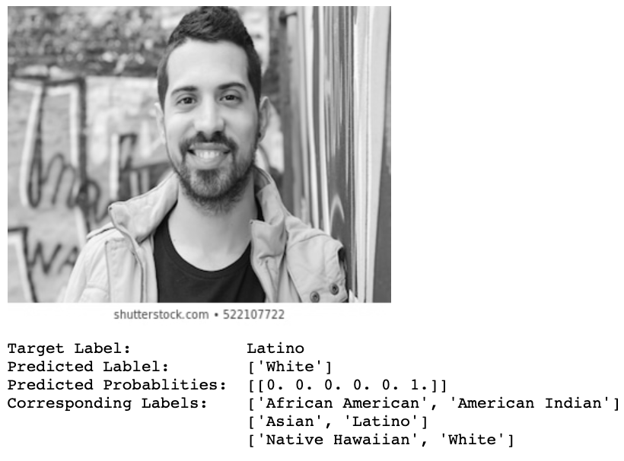
Decision Tree Classifier (Race)
Accuracy Scores
Training data: 99.3%
Testing data: 32.4%

Slide 8
Covid Related Issues

Slide 9
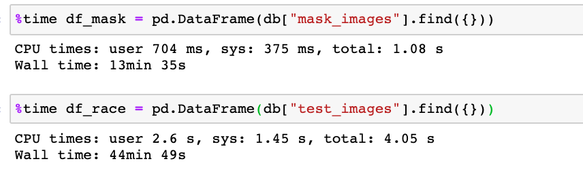
MongoDB Limitations
MongoDB only allows for 500Mb of free storage
~600 images (100 images per category)
Hardware and connectivity issue that could solved by working in a UMBC designated computer lab
Looking at other database option that are free, or provided though UMBC to expand database

Slide 10
Changes

Slide 11
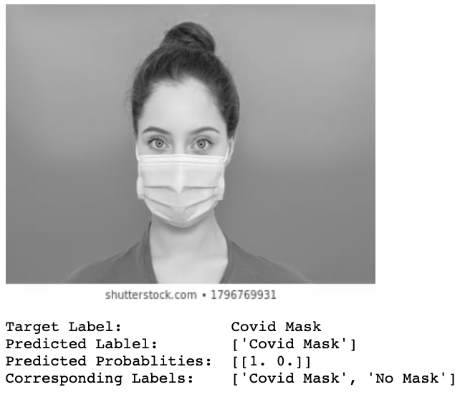
Decision Tree Classifier (Mask vs No Mask)
Previous Model Scores
Training data: 99.3%
Testing data: 32.4%
Current Model Scores
Training data: 100%
Testing data: 77.6%
This implies a bit of overfitting
Overall great start for a binary model
Will also implement a grid cross validation

Slide 12
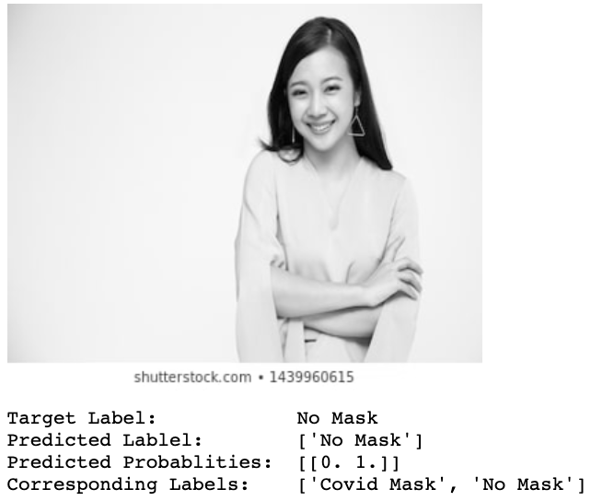
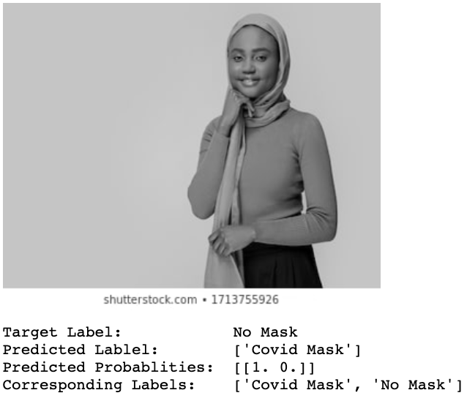
Additional Examples

Slide 13
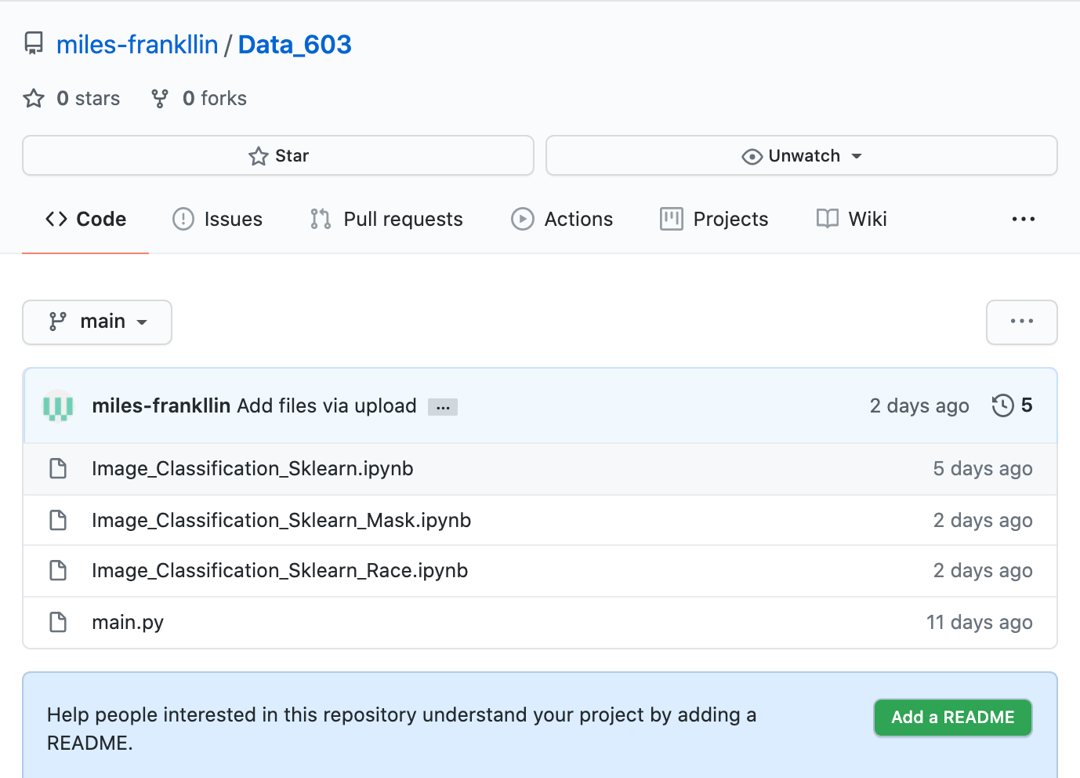
Evidence of Progress
Github Repo (Currently Public)
https://github.com/miles-frankllin/Data_603
main.py
Web scraper that writes into MongoDB
Image_Classification_Sklearn_Race.ipynb
Original attempt, classifying on race
African American, White, American Indian, Asian, Latino, Native Hawaiian
Image_Classification_Sklearn_Mask.ipynb
Current working document
Classifies between wearing a mask and no mask

Slide 14
Goals and Expected Results Moving Forward
Tweak the hyperparameters for the decision tree model
Drop the Native American and Native Images from the set, and replace with more images of people wearing masks
Implement a TensorFlow Neural Network, and real time object classification model
Note, this will still be a fairly difficult task to implement
Move code into a cluster environment (UMBC Azure Cluster for 603)
If implemented correctly, this will substantially cut down on the time it takes to run the code

Slide 15

Questions
Notes:
Image Source: https://www.machinedesign.com/community/article/21836908/what-questions-should-you-ask-during-the-product-lifecycle

